Slide 1
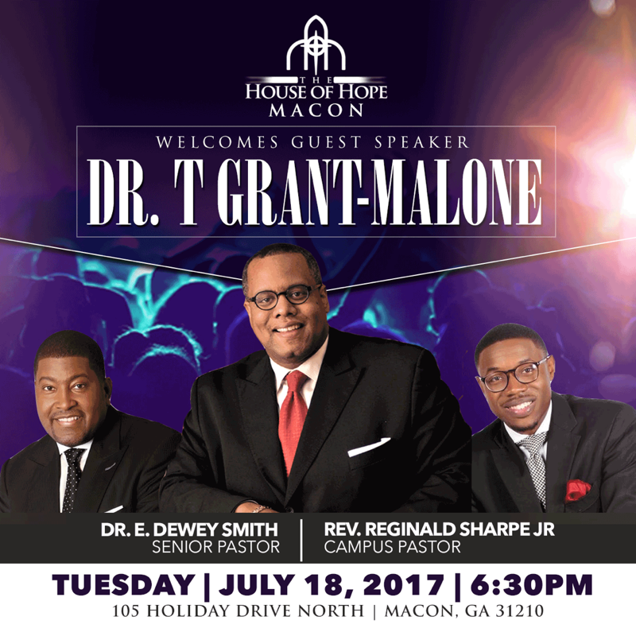

Slide 2
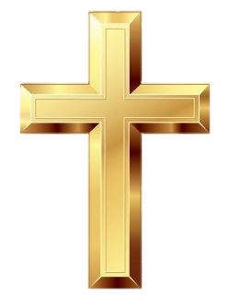
I. The Origin of Church
The English word "church" comes from the Greek word kyriakos meaning "belonging to the Lord" (kyrios).
Ekklēsía ("church") is the root of the terms "ecclesiology" and "ecclesiastical.“
Ekklēsía ek,( "out from and to" and kaléō, "to call") – properly.

Slide 3
People called out from the world and to God, the outcome being the Church (the mystical body of Christ) – i.e. the universal (total) body of believers whom God calls out from the world and into His eternal kingdom.

Slide 4
II. Ownership vs. Stewardship
Many are confused about the words ownership and stewardship.
A steward is simply a manager.
God owns His church (the called people of God) we manage. Prayerfully, the owner is pleased with our managerial skills.

Slide 5
II. Acts = A.D.D.
Acts 2:47 "Praising God and having favor with all the people and the Lord ADDED to the church daily those who were being saved."
ADD (Assimilate , Develop & Deploy)

Slide 6
III. Building the Church
Matthew 16:18 (NIV) And I tell you that you are Peter and on this rock I will build my church, and the gates of Hades will not overcome it.
Excellence through vehicles that matter to church shoppers...
Timelines
Cleanliness
Friendliness (FICs Ministry)
We build people. We meet needs through the Spirit of EXCELLENCE!

Slide 7
IV. It’s Not About You…
1 Corinthians 10:31-So, whether you eat or drink, or whatever you do, do all to the glory of God.
Alan Nelson says, "We must seek to glorify God in every aspect of ministry!

Slide 8
The Christo-Centric Church- John 12:32 Our focus should be a total operation that exemplifies the essence of Jesus Christ.
It's not about us...

Slide 9
Budgets & Bodies don't equate growth, but believers do.
-T. Grant-Malone

